Slide 1
Physics 201
Winter 2013
Beyond collisions

Slide 2

Rocket equation
Winter 2013
The speed of a rocket under propulsion can be seen as an application of Newton’s second law when mass is variable
Or, we can consider the exhaust carrying away momentum against which the rocket is “pushing”
Either way, the resulting velocity is
Change in rocket speed (“delta-v”)
Mass of the propellant
Mass of the rocket
(without propellant)
Exhaust velocity

Slide 3
2D interactions: scattering
Winter 2013
The great thing about conservation laws like energy and momentum is that we can answer many questions without any knowledge of the interaction or details of the collision
On the other hand, one can extract information regarding the interaction from details of the collision – these are called scattering experiments
In history, the first example is Rutherford’s discovery of the atomic nucleus

Slide 4
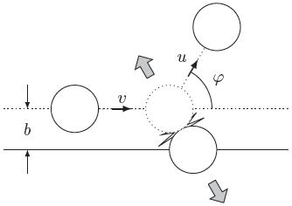
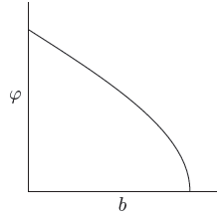
How scattering experiments yield interaction information
Winter 2013
Scattering angle
Scattering angle plot
for a solid sphere
Impact parameter

Slide 5

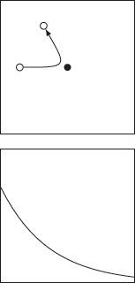
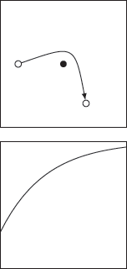
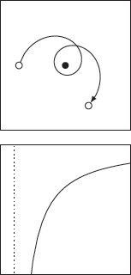
Some more examples
Winter 2013
“Pudding”
model
Rutherford
nucleus
Gravity
slingshot
Einstein
orbit
Trajectory
Scattering
angle plot

Slide 6
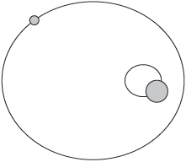
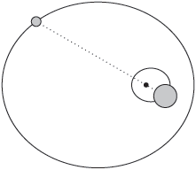
2D interactions: bound orbits
Winter 2013
If the kinetic energy of the particles is less than their potential energy, the particles will orbit each other
The line between the particles always passes through the center of mass
Each particle will orbit the center of mass as if the total mass of the system were concentrated there
Center of mass

Slide 7
The three body problem is a real problem
Winter 2013
We have exhausted the so-called “two-body problem” – what about three?
The three-body problem is unsolvable
Add a third particle and there is literally no way in general to calculate the future position of the system given some arbitrary initial configuration
The only general option available is to use the “step-forward” method on a computer
http://www.freewebz.com/vitaliy/triApplet/triGrav.html

Slide 8
The restricted three body problem
When one mass is much smaller than the others, we can neglect its influence on the other two
The two revolve around the center of mass with constant angular speed – what about the other?
Lagrange realized that in the frame that rotates with the system, we can calculate the effective potential energy in order to answer this question
In particular, he found five points of equilibrium…

Slide 9
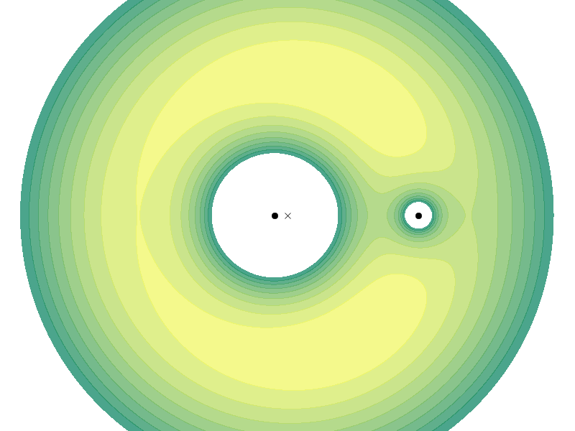





Lagrange points
Winter 2013
Contour map of potential energy
Particle is pushed from light to dark
Center of mass
Mass 1
L4
Mass 2
L1
L2
L3
L5

